Slide 1
PSTAT 126
Billionaires Dataset
Ameya Deshpande, Bowie Chuang, Carter Kulm, Deanna Hu

Slide 2
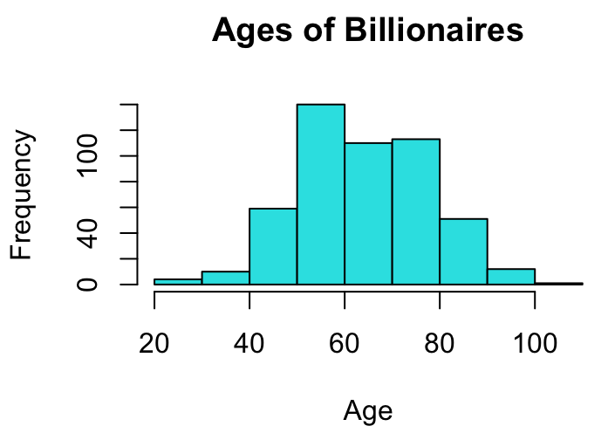
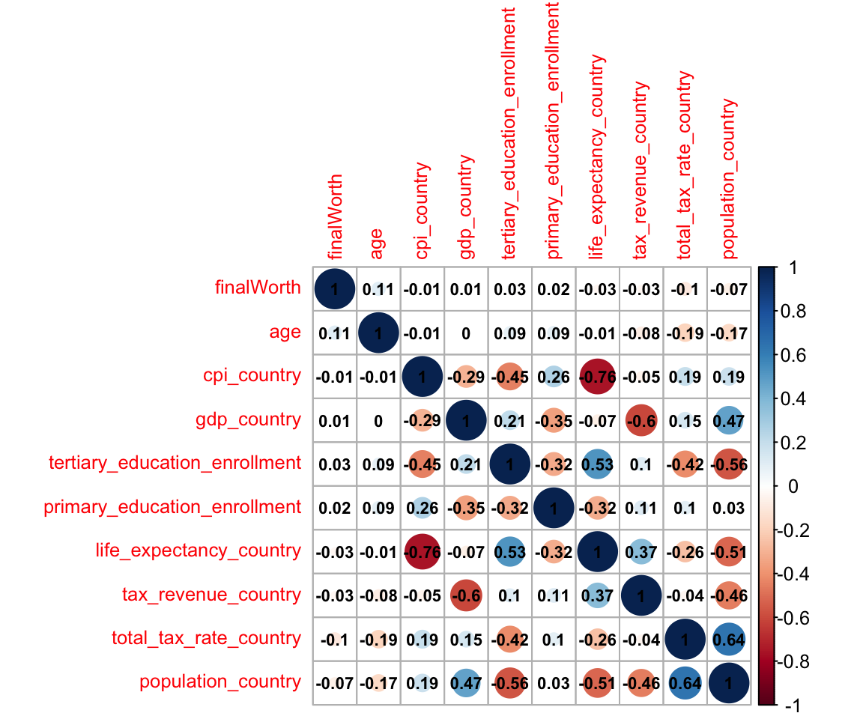
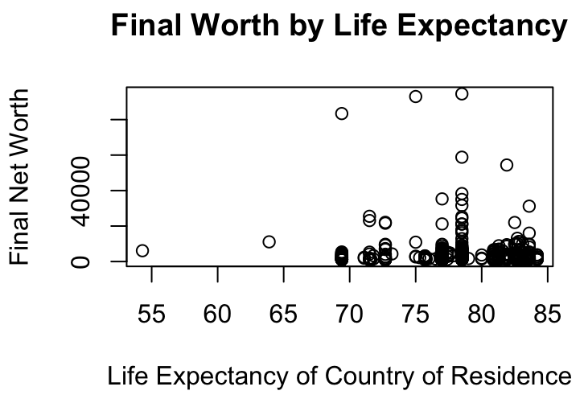
Introduction - Ameya
Billionaire Dataset (Kaggle)
Variables & Correlation
Notes:
Step 1 (Ameya): Dataset
What is the Billionaires dataset & why we chose it
Some variables we looked at & correlations we found - also mention if any variables were transformed
Note that a lot of the variables were concerned with the country that the billionaires were from and not specifically about the billionaires themselves
Strongest correlation between life expectancy and CPI
Also correlations between gdp and tax revenue

Slide 3
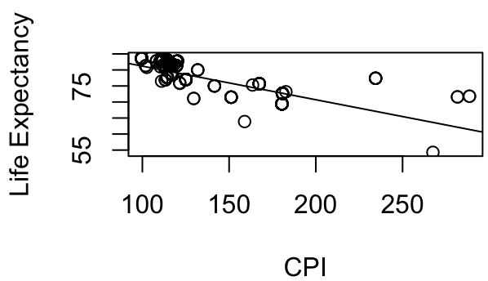


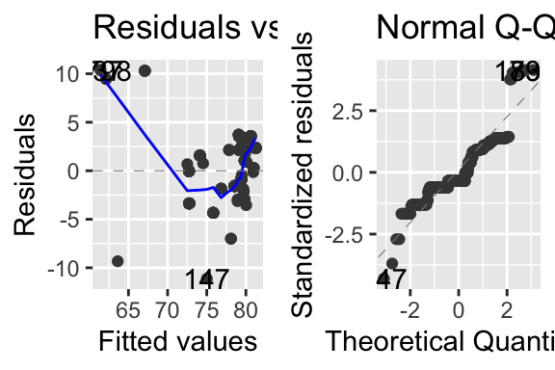
Hypothesis Testing
Explanatory variable: Country CPI
Response variable: Country Life Expectancy
Assumptions
Independence, Normality, Variance
Hypothesis:
Confidence Interval for beta_1: (-0.11285, -0.09703)
Notes:
Step 2 (Deanna): CIs and PIs
Why we chose those variables to test
Highest correlation bw the two, wanted to see if there was any true relationship
Null hypothesis: There is no relationship between the two variables
Alternate hypothesis: There is a relationship between the two variables
Findings: there is a strong correlation between the two variables

Slide 4
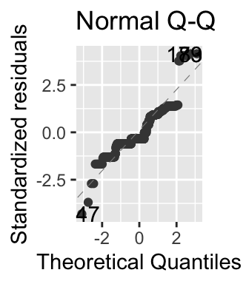
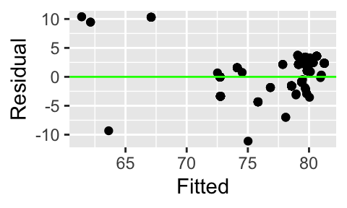
Linearity
Multiple R-squared value: 0.57723
Adjusted R-squared value: 0.57638
Transformations
long(life expectancy)
Notes:
Step 2 (Deanna): Linearity and Fit
R^2 value - 57.7% of variation was explained by the predictor
Interesting findings
Transformation did not result in huge changes
Data points were not randomly dispersed, a transformed model would provide more accuracy
Not normally distributed, interesting clusters in data
Transformations & results
log(life expectancy) did not bring major changes to Adjusted R^2 value
Conclusion: first degree lin reg was not the best model for the data

Slide 5
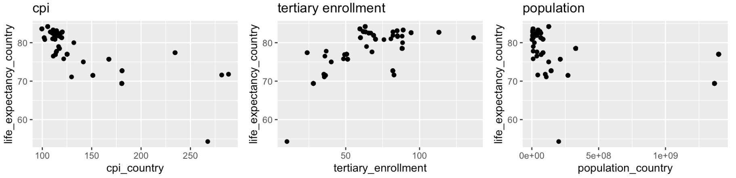
Feature Engineering
Transformations: applied log transformation onto cpi, tertiary enrollment, population
Tested reduced model (above) against full model (below), full model significantly better
Notes:
Step 3 (Carter) Feature Engineering:
Based on scatter plots with life expectancy on y-axis, predictors on x-axis, log transformations would increase association (did increase each pearson correlation coefficient by at least 5%.
Did a nested model test on reduced model vs full model (that each coefficient in the full model is not significant), got a p value of 0, meaning that the full model is significantly better than the reduced model.

Slide 6
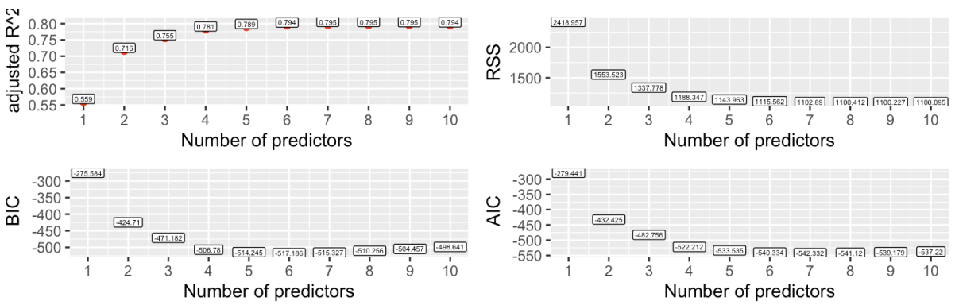
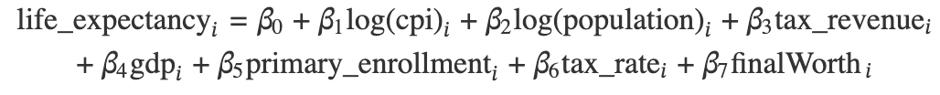
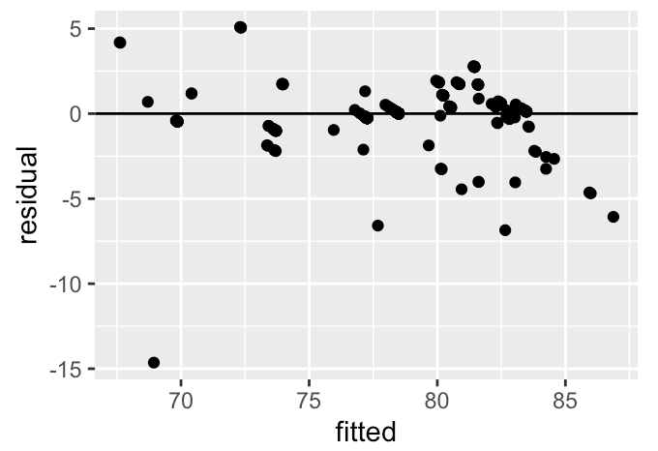
Statistical Model
Used forward selection to reduce model to 7 predictors
Chosen model:
Residual Plot:
95% Confidence Interval for mean life expectancy: (76.81, 77.11)
95% Prediction Interval for mean life expectancy: (75.25, 81.67)
Notes:
Step 3 (Carter): Statistical Model
Used forward selection to determine which predictors to include at each number of predictors in a model.
Based on the adjusted R^2, RSS, BIC, and AIC we went with 7 predictors. Went with this to prioritize predictive accuracy over selection consistency.
Residual plot shows some heteroskedasticity near the larger fitted values

Slide 7
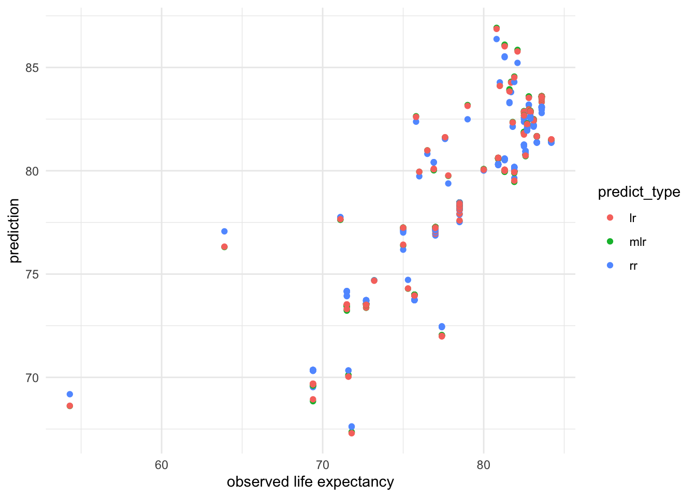
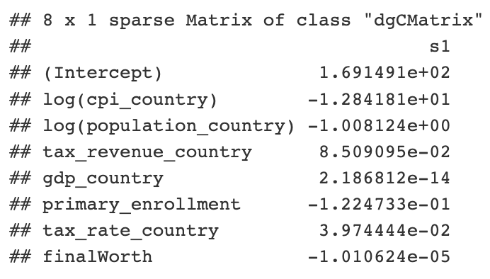
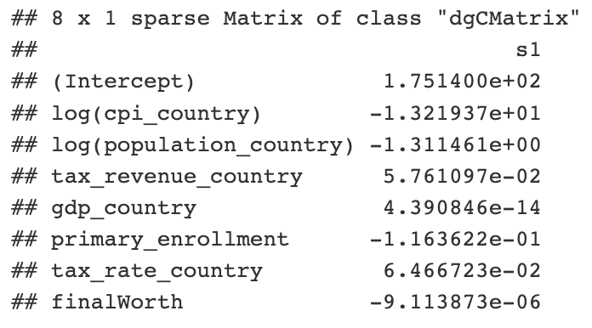
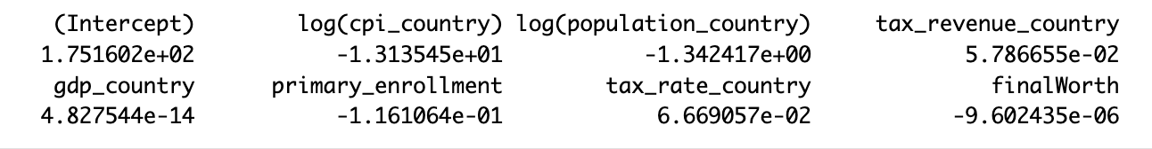
Shrinkage (Ridge vs. Lasso vs. MLR)
Ridge Regression
Lasso Regression
Fitted Model
Notes:
Step 4 (Bowie): Visualization
Applied shrinkage methods to avoid overfitting and reduce complexity of model
RR: Coefficients did not change very much compared to before (step 3)
LR: Coefficients were also pretty similar to RR values
Results:
Strong correlation seen between observed and predicted values
Vs. Ridge Regression values (kind of separated)
Vs. Multiple Linear regression predicted values

Slide 8
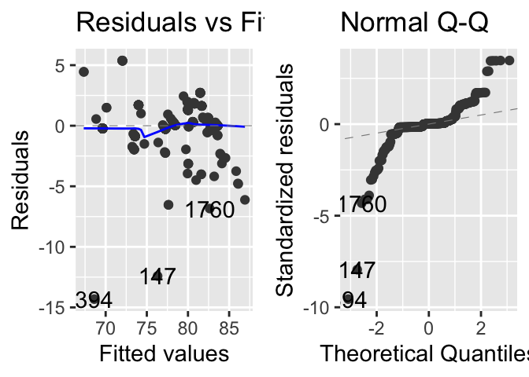
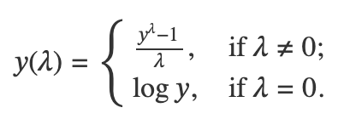

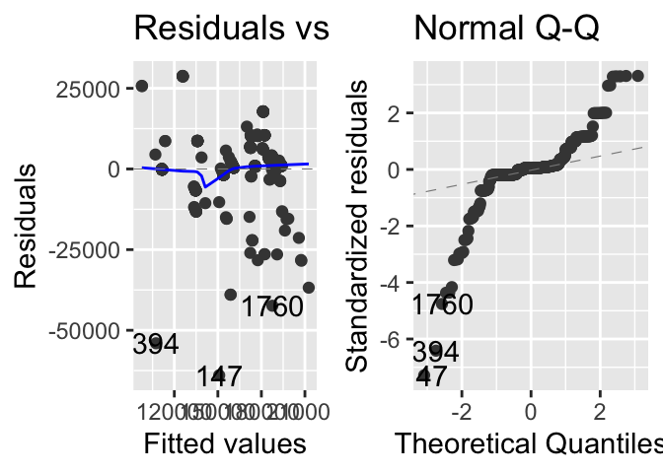
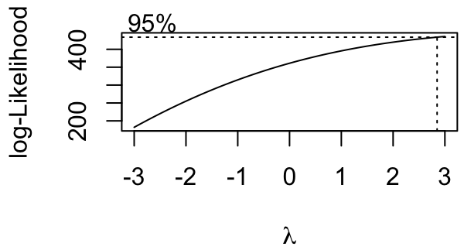

Box-Cox Method (Innovation)
Purpose
Implementation
Results, Adjusted R-squared values
Notes:
Step 4 (Bowie) - something new (Box Cox transformations)
Why do people use Box Cox Method (what for)?
Stabilizes variance and makes data more normally distributed, more likely for dataset to be homoscedastic, improves model fit and accuracy
Approach, how the method was implemented
What lambda is for - optimal value for transformation
Any findings?
Not rly, Adjusted R^2 only increased by 1.2%
Transformation did not largely affect our results

Slide 9
Conclusion - Ameya
Interesting findings
Data Observations
Methods
Final comments
Notes:
Step 4 (Ameya) Summary:
Interesting findings
Lots of disparity and spread of net worths amongst billionaires themselves
Billionaires in Nigeria and Africa cause a Large disparity in wealth in their respective countries
Data observations - the data did not reflect solely billionaire statistics, but of the countries that billionaires lived in most commonly, which directed our results to be a bit different from what we were expecting when we first selected this data set to analyze
Methods
Transformations drastically altered fit with response variable
Manual vs. Selection methods of variables was interesting to see how they provided different results
Final comments -

